Slide 1
Transition state search, Transition state optimization, Frequency calculation, Thermodynamic parameters
Instructor: Prof. Tzuhsiung (Nick) Yang
Email: tyang@mx.nthu.edu.tw
Time: M5/6
Room: NTHU Library Comp Lab II
Notes:
Rafael Gomez

Slide 2
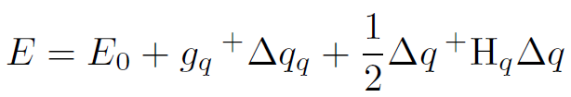
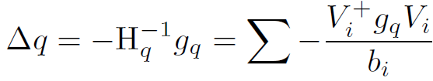
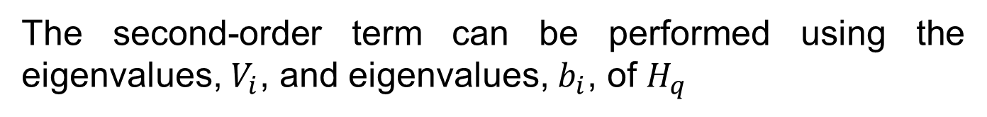
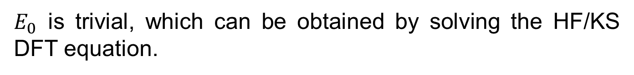
Geometry optimization
Similar, we can optimize the energy of the system, which is a function of nuclear coordinates
is the energy at the initial coordinate, is the transpose of the nuclear gradient vector, is the step size of update,
is the nuclear Hessian.
The second-order term can be performed using the eigenvalues, $V_{i}$, and eigenvalues, $b_{i}$, of $H_{q}$
This requires us to obtain three quantities: $E_{0}$, $g_{q}$, and $H_{q}$
$E_{0}$ is trivial, which can be obtained by solving the HF/KS DFT equation.

Slide 3
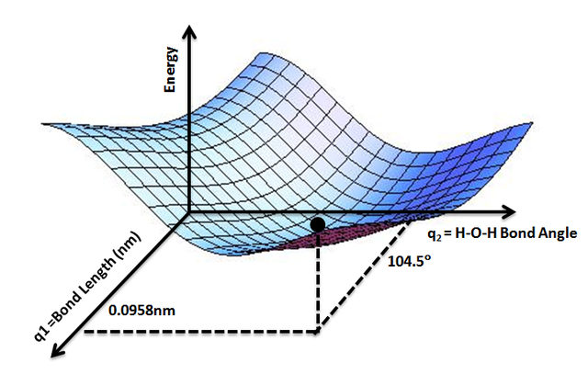
Geometry optimization

Slide 4
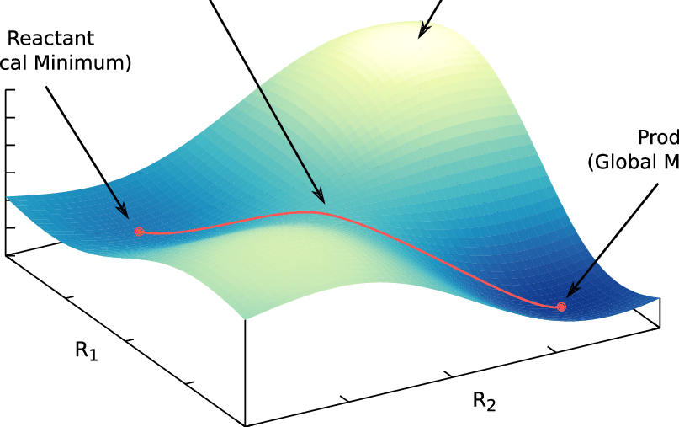
Transition state search
Transition states are first-order saddle points, meaning that they are at the minima of all degrees of freedom except one at which they are at the maximum.
Because of their sparce nature, TS optimization requires good initial guess structures (to minimize energy extrapolation from E₀)
There are multiple methods to locate a good initial guess structure for a TS:
Relaxed surface scan,
Nudged elastic band,

Slide 5
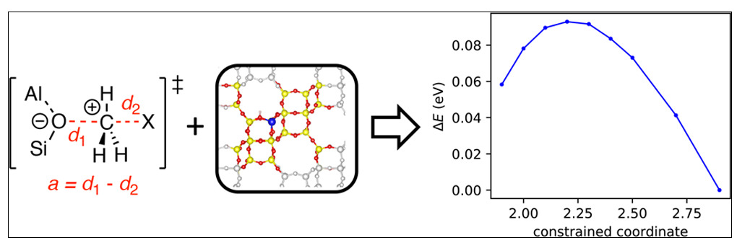
Relaxed surface scan
Relaxed surface scan is performed by optimizing the geometry of a molecule at a set of constrained internal coordinates (e.g. a set of specified bond distances).
For example, one can scan the bond distance between a nucleophile and a halomethane to find the S_{N}2 TS.
There are a few points about this method:
The size of the steps will determine how close is the obtained structure to the TS structure.
Prior knowledge about the nature of the TS is assumed.

Slide 6
Nudged Elastic Band
The Nudged Elastic Band (NEB) method is used to find a minimum energy path (MEP) connecting two local energy minima on the potential energy surface (PES) and thereby an estimate of the activation energy for the transition.
The two minima are referred to as the reactant and product in the following discussion. The path can have one or more maxima, each one corresponding to a first-order saddle point on the energy surface.
The NEB method offers an advantage over eigenvector-following methods in that it is guaranteed to find saddle points that connect the given reactant and product states.

Slide 7
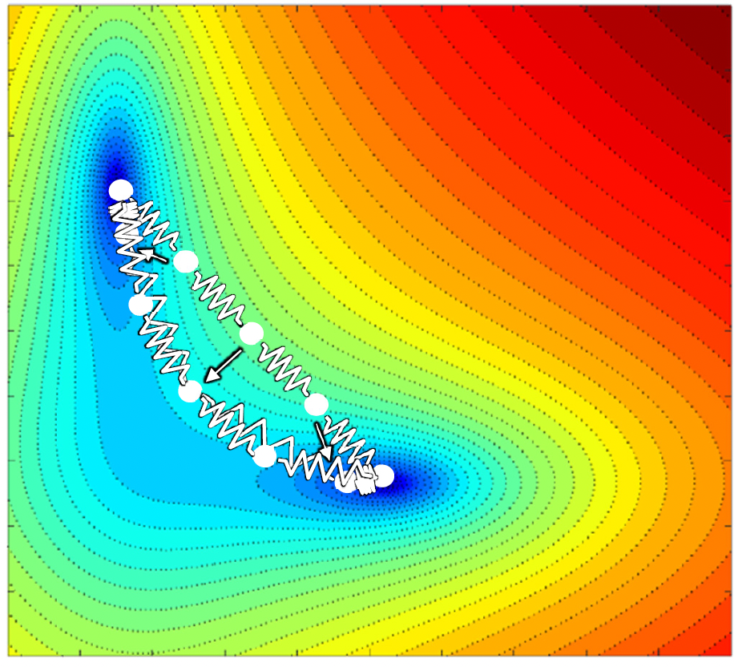
Nudged Elastic Band
Upon the provision of optimized reactant and product structures, M “images” are generated.
Neighboring images are connected via “springs”.
The larger the difference between the images the larger the restoring force of the spring.
The calculation attempts to minimize the energies of the structures and the energy of the springs.

Slide 8
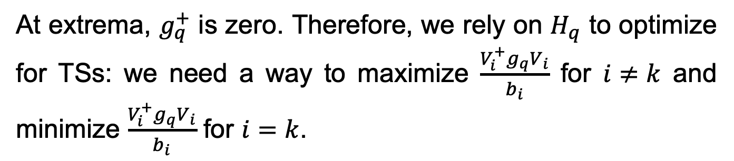
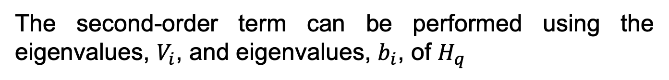
Transition state search
Recall the Taylor series expansion of E
The second-order term can be performed using the eigenvalues, $V_{i}$, and eigenvalues, $b_{i}$, of $H_{q}$
At extrema, $g_{q}^{+}$ is zero. Therefore, we rely on $H_{q}$ to optimize for TSs: we need a way to maximize $\frac{V_{i}^{+}g_{q}V_{i}}{b_{i}}$ for $i≠k$ and minimize $\frac{V_{i}^{+}g_{q}V_{i}}{b_{i}}$ for $i=k$.

Slide 9
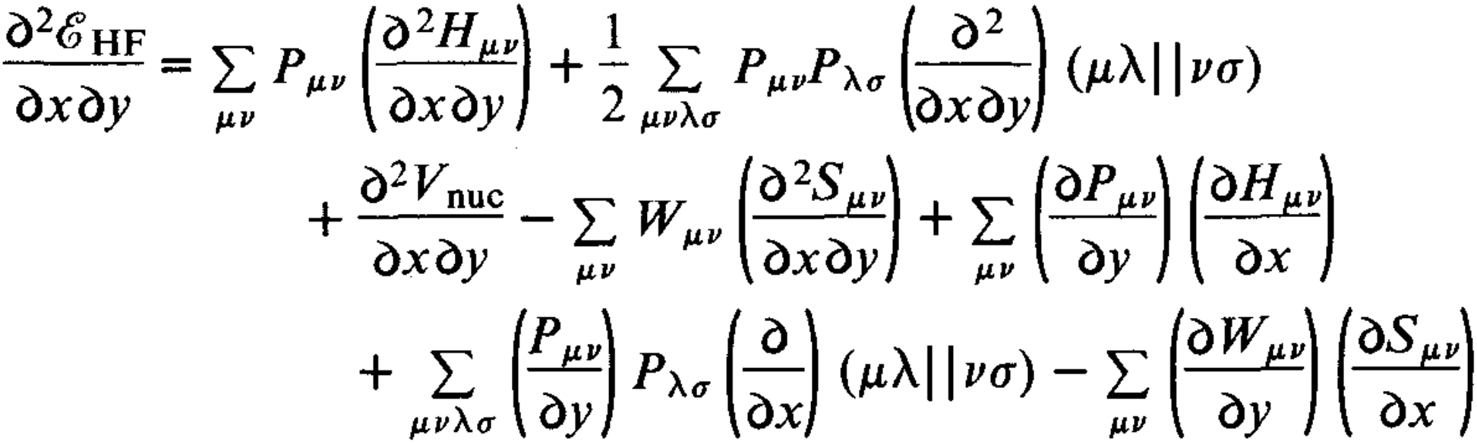
Validate an optimized TS
To validate the optimized TS structure, we will perform a frequency calculation on top of the optimized structure by solving the coupled-perturbed SCF equation
The correct TS structure should only have one vibrational mode with negative eigenvalue (imaginary mode).
We can then visualize the vibration using orca_pltvib

Slide 10
Interactive: TS search
In this practice, we will perform a S_{N}2 TS search and optimization for the reaction between hydroxide and chloromethane using B3LYP (UKS) and def2-SVP basis set using relaxed surface scan.
Build a “good” initial structure for the reaction using Avogadro
Perform optimization (opt) with a sequence of bond distances. The command block looks like:
%geom scan b x y = a, b, c end end (x and y are atom indices starting at 0, a and b are the initial and final bond distance, and c is the number of steps)
Submit the calculation

Slide 11
Interactive: TS opt
In this practice, we will optimize the structure that has the highest energy among the scanned structure. As we have already seen, we also need a good Hessian to perform the shift on the Newton-Raphson step.
Take the xyz with the highest energy then run a frequency calculation on it using the keyword !anfreq
Perform a TS optimization (!optts) with the Hessian (.hess) and orbital (.gbw) files provided.

Slide 12
Interactive: TS validation
In this practice, we will run another frequency calculation using the optimized TS structure.
Take the xyz with the highest energy then run a frequency calculation on it using the keyword !anfreq
Check the output file for the mode with the negative eigenvalue (imaginary mode)
Plot the mode using orca_pltvib xxx.hess mode_number (remember to module load orca/4.2 first)
Export the generated xyz and visualize it using Avogadro.

Slide 13
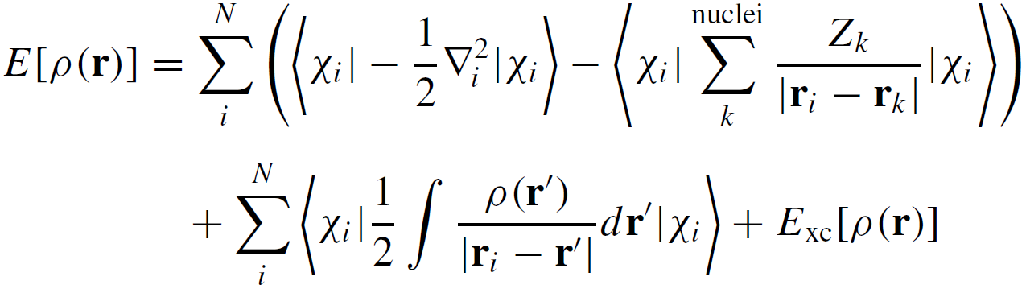
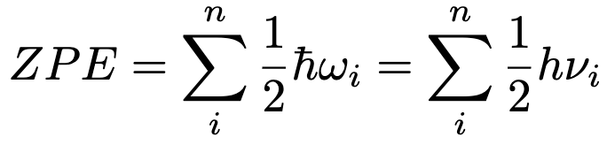
Thermodynamic parameters
Recall from thermodynamics, the Gibbs free energy is
The internal energy can be separated into five components:
Electronic energy (determined by solving the mean field equation),
the zero temperature vibrational energy (ZPE)

Slide 14
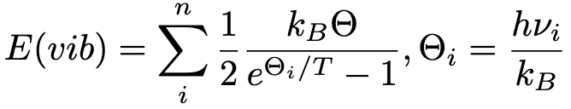
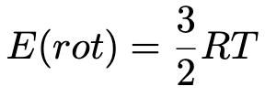
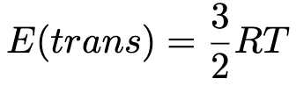
Thermodynamic parameters
Recall from thermodynamics, the Gibbs free energy is
The internal energy can be separated into five components:
Thermal population of vibrational states,
thermal rotational energy, and
thermal translational energy

Slide 15
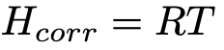
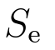
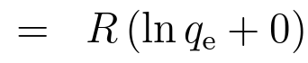
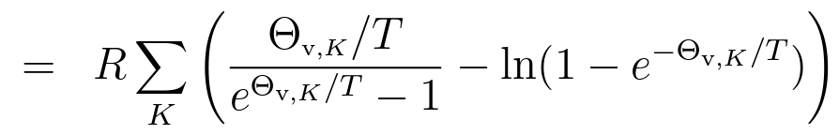
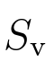
Thermodynamic parameters
The enthalpic correction is just the thermal energy
Entropy has four components:
Electronic entropy
Vibrational entropy
,

Slide 16
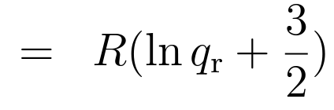
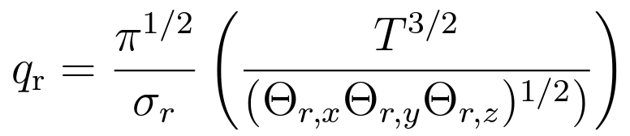
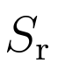
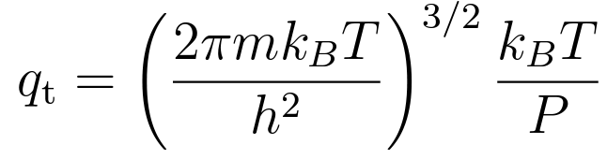
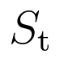
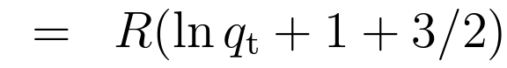
Thermodynamic parameters
The enthalpic correction is just the thermal energy
Entropy has four components:
Rotational entropy
Translational entropy
,
,

Slide 17
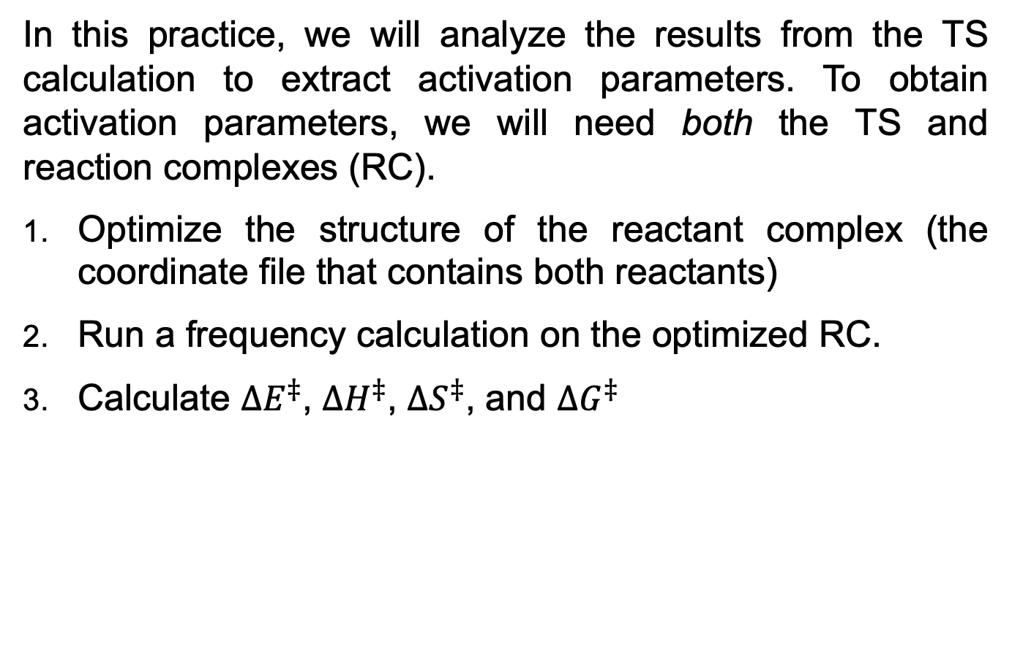
Interactive: thermodynamic
In this practice, we will analyze the results from the TS calculation to extract activation parameters. To obtain activation parameters, we will need both the TS and reaction complexes (RC).
Optimize the structure of the reactant complex (the coordinate file that contains both reactants)
Run a frequency calculation on the optimized RC.
Calculate $ΔE^{‡}$, $ΔH^{‡}$, $ΔS^{‡}$, and $ΔG^{‡}$

